Slide 1
Hibernate

Slide 2
Overview
ORM framework created by Gavin King back in 2001.
Free software distributed by the GNU Lesser General Public License.
Supports data persistence and data retrieval.
Provides own query language called Hibernate Query Language (HQL).

Slide 3
Maven dependency
<dependency>
<groupId>org.hibernate</groupId>
<artifactId>hibernate-core</artifactId>
<version>4.3.6.Final</version>
</dependency>

Slide 4
Basic concepts

Slide 5
hibernate.properties
Property | Used for
hibernate.dialect | Makes Hibernate generate the appropriate SQL for the chosen database.
hibernate.connection.driver_class | The JDBC driver class.
hibernate.connection.url | The JDBC URL to the database instance.
hibernate.connection.username | The database username.
hibernate.connection.password | The database password.
hibernate.hbm2ddl.auto | Validates or exports the schema DDL to the database. Possible values include "validate", "update", "create" and "create-drop"
hibernate.show_sql | Controls whether Hibernate should print the SQL queries it executes against the database.
hibernate.format_sql | Controls whether Hibernate should format the SQL queries it prints.

Slide 6
hibernate.properties example
hibernate.dialect = org.hibernate.dialect.PostgreSQLDialect
hibernate.connection.driver_class = org.postgresql.Driver
hibernate.connection.url = jdbc:postgresql://localhost:5432/library-with-hibernate
hibernate.connection.username = postgres
hibernate.connection.password = postgres
hibernate.hbm2ddl.auto = update
hibernate.show_sql = false
hibernate.format_sql = true

Slide 7
Important API classes
Class | Used for
Configuration | The first object created in any Hibernate application once during the application initialization. It represents a configuration or properties file required by Hibernate which contain information such as database connection properties and class mapping setup.
SessionFactory | One instance created from the Configuration object during application initialization. The object is thread safe and used to create instances of the Session class.
Session | Used to get a physical connection with a database. It's lightweight and designed to be instantiated each time an interaction is needed with a database. The class is not thread safe and should not be kept open for long.
Transaction | Represents a unit of work with the database.
Query | Use SQL or HQL (Hibernate Query Language) to retrieve data from a database or query objects.
Criteria | Used to create and execute object-oriented criteria queries to retrieve objects.

Slide 8
Common usage scenario
Configuration configuration = new Configuration();
ServiceRegistry serviceRegistry = new StandardServiceRegistryBuilder().applySettings(
configuration.getProperties()).build();
sessionFactory = configuration.addAnnotatedClass(Book.class).buildSessionFactory(serviceRegistry);
Session session = sessionFactory.openSession();
Transaction tx = null;
try { tx = session.beginTransaction();
// Do some work…
tx.commit();
} catch (RuntimeException e) {
if (tx != null) { tx.rollback(); }
// Handle exception…
} finally {
session.close();
}
sessionFactory.close();

Slide 9
Creating and saving an entity
Session session = sessionFactory.openSession();
Transaction tx = null;
try {
tx = session.beginTransaction();
Book book = new Book();
book.setIsbn("isbn");
book.setTitle("title");
session.save(book);
tx.commit();
} catch (RuntimeException e) {
if (tx != null) { tx.rollback(); }
throw e;
} finally {
session.close();
}

Slide 10
Finding and updating an entity
Session session = sessionFactory.openSession();
Transaction tx = null;
try {
tx = session.beginTransaction();
Book book = (Book) session.get(Book.class, 8L);
book.setTitle("Corrected Title");
session.save(book);
tx.commit();
} catch (RuntimeException e) {
if (tx != null) { tx.rollback(); }
} finally {
session.close();
}

Slide 11
Persistent classes and mapping

Slide 12
Persistent classes
Java classes whose objects or instances will be stored in database tables are called persistent classes in Hibernate. It's best if these classes follow these rules:
All Java classes that will be persisted need a default constructor.
All classes should contain an ID in order to allow easy identification of your objects within Hibernate and the database. This property maps to the primary key column of a database table.
All attributes that will be persisted should be declared private and have getter and setter methods defined in the JavaBean style.
A central feature of Hibernate, proxies, depends upon the persistent class being either non-final, or the implementation of an interface that declares all public methods.

Slide 13
Mapping
Defines the relationship between the application's object data model to the database's relational data model.
How classes map to tables
How class attributes map to table columns
Which class attribute is going to be used as a primary key
What primary key generation strategy is to be used
Etc.
Hibernate provides two mapping models:
Through XML configuration files
By using annotations

Slide 14
Annotation based mapping
Annotation | Annotates | Used for
@javax.persistence.Entity | Class | Marks a class as a persistent class i.e. an entity bean. The class must have a no-argument constructor.
@javax.persistence.Table | Class | Specifies the details of the table that will be used to persist the table in the database.
@javax.persistence.Id | Field | Marks the field that will be used as a primary key.
@javax.persistence.GeneratedValue | Field | Used alongside @Id to specify that Hibernate should take care of generating the primary key value using some strategy.
@javax.persistence.Column | Field | Used to specify the details of the column to which the field will be mapped. It provides attributes such as "name", "length", "nullable", "unique".

Slide 15
Annotation based mapping example
@Entity
@Table(name = "book")
public class Book {
@Id @GeneratedValue private Long id;
@Column(name = "isbn") private String isbn;
@Column(name = "title") private String title;
public Book() { }
public String getIsbn() { return isbn; }
public void setIsbn(String isbn) { this.isbn = isbn; }
public String getTitle() { return title; }
public void setTitle(String title) { this.title = title; }
}

Slide 16
Hibernate Query Language

Slide 17
Hibernate Query Language (HQL)
Similar to SQL, but instead of operating on tables and columns, HQL works with persistent objects and their properties.
Understands notions such as inheritance, polymorphism and associations.
HQL queries are translated into RDBMS specific SQL upon execution.

Slide 18
FROM clause
Used to load objects into memory.
Example:
String hql = "FROM Book"; Query query = session.createQuery(hql); List results = query.list();

Slide 19
SELECT clause
Provides more control over the result set than the FROM clause.
Example:
String hql = "SELECT B.title FROM Book B"; Query query = session.createQuery(hql); List results = query.list();

Slide 20
WHERE clause
Used to narrow the list of objects that should be returned from the storage.
Example:
String hql = "FROM Book B WHERE B.id = 10"; Query query = session.createQuery(hql); List results = query.list();

Slide 21
ORDER BY clause
Used to sort the results returned from an HQL query.
The results can be ordered by any property of the objects in the result set either ascending (ASC) or descending (DESC).
Examples:
String hql = "FROM Book B WHERE B.id > 10 ORDER BY B.title DESC"; Query query = session.createQuery(hql); List results = query.list();
String hql = "FROM Book B WHERE B.id > 10 ORDER BY B.title DESC, B.isbn ASC"; Query query = session.createQuery(hql); List results = query.list();

Slide 22
GROUP BY clause
Allows Hibernate pull information from the database and group it based on a value of an attribute, and typically, use the result to include an aggregate value.
Example:
String hql = "SELECT COUNT(LB.id), LB.isbn FROM LentBook LB GROUP BY LB.isbn"; Query query = session.createQuery(hql); List results = query.list();

Slide 23
Using named parameters
Named parameters are supported in HQL queries. This protects the application against syntax errors in the HQL code as well as from SQL injection attacks.
Example:
String hql = "FROM Book B WHERE B.id = :book_id"; Query query = session.createQuery(hql); query.setParameter("book_id", 10); List results = query.list();

Slide 24
UPDATE clause
Update statements in Hibernate are executed using the Query.executeUpdate() method.
Example:
String hql = "UPDATE Book set title = :title WHERE id = :book_id"; Query query = session.createQuery(hql); query.setParameter("title", 1000); query.setParameter("book_id", 10); int result = query.executeUpdate(); System.out.println("Rows affected: " + result);

Slide 25
DELETE clause
Deleting an object is supported through the Query.executeUpdate() method as well.
Example:
String hql = "DELETE FROM Book WHERE id = :book_id"; Query query = session.createQuery(hql); query.setParameter("book_id", 10); int result = query.executeUpdate(); System.out.println("Rows affected: " + result);

Slide 26
Pagination using Query
Example:
String hql = "FROM Book"; Query query = session.createQuery(hql); query.setFirstResult(1); query.setMaxResults(10); List results = query.list();

Slide 27
Criteria API

Slide 28
Criteria queries
The Criteria API can be used to build up a criteria query object programmatically where you can apply filtration rules and logical conditions.
Created through the Session.createCriteria() method.
Example:
Criteria cr = session.createCriteria(Employee.class); List results = cr.list();

Slide 29
Restrictions with criteria
Using the Criteria.add() method, restrictions can be added to the criteria query.
Example:
Criteria cr = session.createCriteria(Employee.class); cr.add(Restrictions.eq("salary", 2000)); List results = cr.list();

Slide 30
More examples on restrictions
Criteria cr = session.createCriteria(Employee.class);
// To get records having salary more than 2000 cr.add(Restrictions.gt("salary", 2000));
// To get records having fistName starting with zara
cr.add(Restrictions.like("firstName", "zara%"));
// To get records having salary in between 1000 and 2000
cr.add(Restrictions.between("salary", 1000, 2000));
// To check if the given property is null
cr.add(Restrictions.isNull("salary"));
// To check if the given property is empty
cr.add(Restrictions.isEmpty("salary"));

Slide 31
Combining conditions using AND or OR
Criteria cr = session.createCriteria(Employee.class);
Criterion salary = Restrictions.gt("salary", 2000);
Criterion name = Restrictions.ilike("firstNname","zara%");
// To get records matching with OR condistions
LogicalExpression orExp = Restrictions.or(salary, name);
cr.add( orExp );
// To get records matching with AND condistions
LogicalExpression andExp = Restrictions.and(salary, name);
cr.add( andExp );
List results = cr.list();

Slide 32
Pagination using criteria
Criteria cr = session.createCriteria(Employee.class);
cr.setFirstResult(1);
cr.setMaxResults(10);
List results = cr.list();

Slide 33
Sorting results
Criteria cr = session.createCriteria(Employee.class);
// To get records having salary more than 2000
cr.add(Restrictions.gt("salary", 2000));
// To sort records in descening order
crit.addOrder(Order.desc("salary"));
// To sort records in ascending order
crit.addOrder(Order.asc("salary"));
List results = cr.list();

Slide 34
Exercises

Slide 35
Exercise: Library
Modify the Library application to support data access layer based on Hibernate in addition to the one based on JDBC.

Slide 36
Application: AliExpress
Modify the AliExpress application to support data access layer based on Hibernate in addition to the ones based on JDBC and the in-memory model.

Slide 37
Mapping inheritance

Slide 38
Mapping inheritance
Inheritance is a concept that has no support in the RDBMS world. Hibernate works around this issue by providing three inheritance implementation strategies:
Table per class strategy
Single table per class hierarchy strategy
Joined subclass strategy

Slide 39
Table per class strategy
Implementation: Each subclass gets its own table.
Advantages:
No joins or unions needed when querying data from a single subclass
Disadvantages:
Unions are needed to join the data when querying polymorphic data (from multiple subclasses)
Metadata duplication: columns for mutual attributes get created multiple times in the different tables

Slide 40
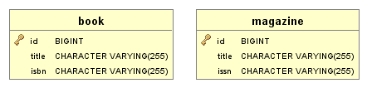
Table per class strategy example

Slide 41
Joined subclass strategy
Implementation: Columns of mutual attributes are grouped in a separate table; subclass-specific attributes get their own tables.
Advantages:
Closely resembles the polymorphism of OO languages
No metadata duplication
Disadvantages:
Joins are needed when querying data from a single subclass
Joins are needed when querying polymorphic data

Slide 42
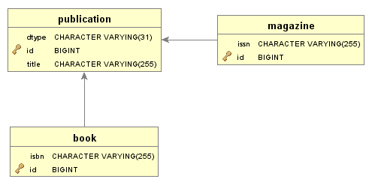
Joined subclass strategy example

Slide 43
Single table per class hierarchy strategy
Implementation: Single table to store all data.
Advantages:
No joins or unions needed when querying data from a single subclass
No joins or unions needed when querying polymorphic data
No metadata duplication
Disadvantages:
Null values in columns not used by a specific subclass; can't enforce not-null constraints in the RDBMS

Slide 44
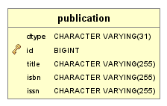
Single table per class hierarchy strategy example

Slide 45
Inheritance strategies comparison matrix
 | Table per class | Joined subclass | Single table
Querying data from a single subclass | O | X | O
Querying polymorphic data | X | X | O
Metadata duplication | X | O | O
Null values in columns | O | O | X

Slide 46
Inheritance mapping example
@Entity
@Inheritance(strategy = InheritanceType.TABLE_PER_CLASS)
@DiscriminatorColumn(discriminatorType = DiscriminatorType.STRING)
public abstract class Publication {...}
@Entity
@DiscriminatorValue("book")
public class Book extends Publication {...}
@Entity
@DiscriminatorValue("magazine")
public class Magazine extends Publication {...}

Slide 47
Mapping entity associations/relationships

Slide 48
Mapping entity associations/relationships
Supported association/relationship types:
One-to-one
One-to-many / many-to-one
Many-to-many
Direction:
Unidirectional
Bidirectional

Slide 49
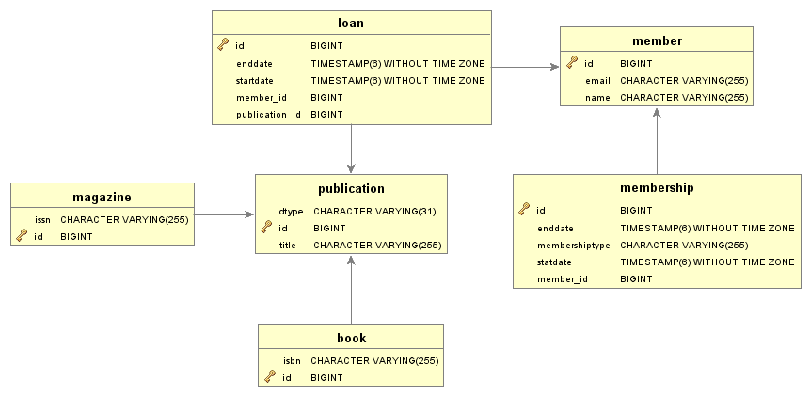
Database model

Slide 50
One-to-one
@Entity
public class Member {
@OneToOne(mappedBy = "member")
private Membership membership;
}
@Entity
public class Membership {
@OneToOne
private Member member;
}

Slide 51
One-to-many (many-to-one)
@Entity
public class Member {
@OneToMany(mappedBy = "member")
private Set<Loan> loans; }
@Entity
public class Loan {
@ManyToOne
private Member member; }

Slide 52
Many-to-many
@Entity
public class Member {
@ManyToMany(mappedBy = "members")
private Set<Publication> publications;
}
@Entity
public class Publication {
@ManyToMany
@JoinTable(name = "loan",
joinColumns = @JoinColumn(name = "publication_id"),
inverseJoinColumns = @JoinColumn(name = "member_id"))
private Set<Member> members;
}

Slide 53
Exercises

Slide 54
Exercise: Library
Modify the Library application:
Include support for magazine publications in addition to the current support for books.
Add functionality for member registration.
Add functionality for lending publications.

